Slide 1
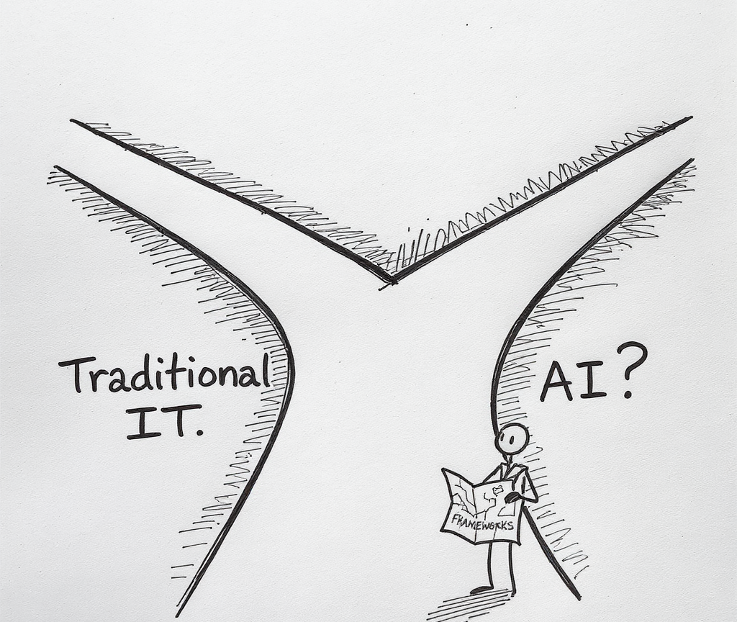
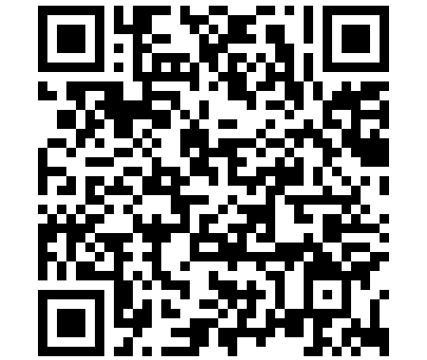
AI-Driven Business Innovation
Strategic Frameworks for AI Investment Decisions
Dr. Michael Borck | Curtin University
Notes:
How is evaluating AI investments DIFFERENT from traditional IT investments?
By end of day, you’ll know:
5 ways AI differs from traditional IT
5 AI-specific evaluation criteria
Why highest ROI ≠ best AI investment

Slide 2
Today’s Schedule
Morning Session:
What Makes AI Different
Exercise 1: AI Tech Radar
Strategic Frameworks
Exercise 2: AI-Assisted Strategic Analysis
Afternoon Session:
AI Investment Model
Exercise 3: Dragon’s Den
Exercise 4: Strategic Response Scenarios
Debrief & Action Planning

Slide 3
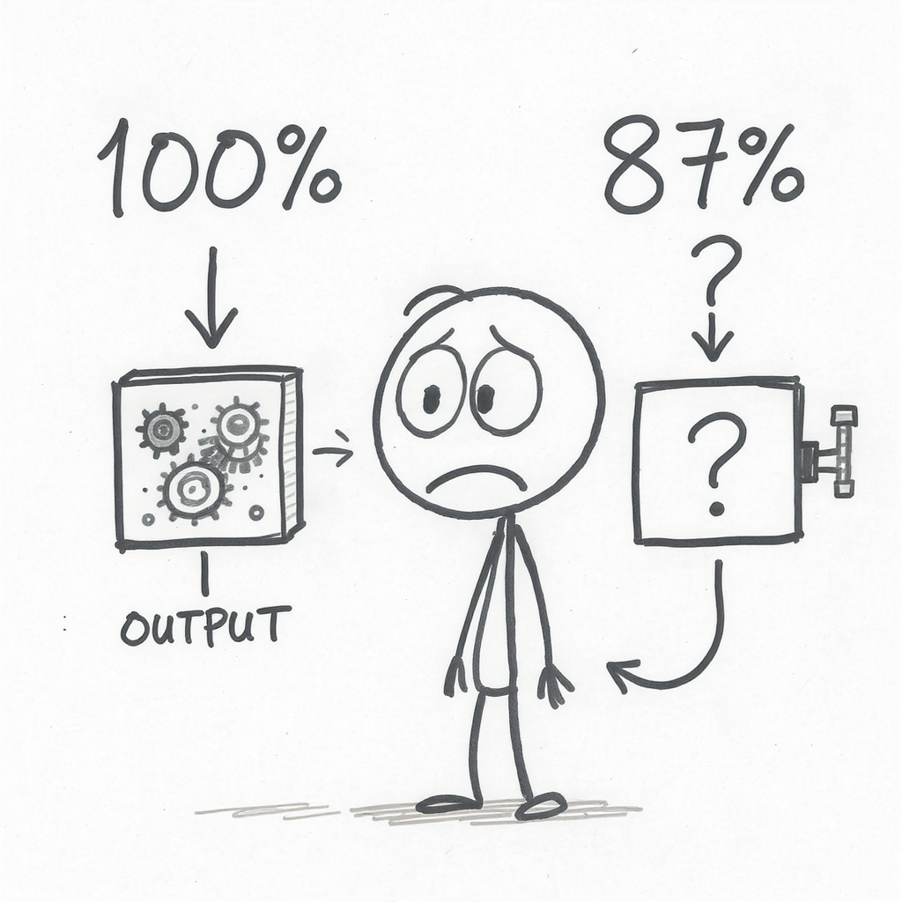
Traditional vs. AI
AI Generated Image
Notes:
Implication: AI needs DIFFERENT evaluation criteria

Slide 4
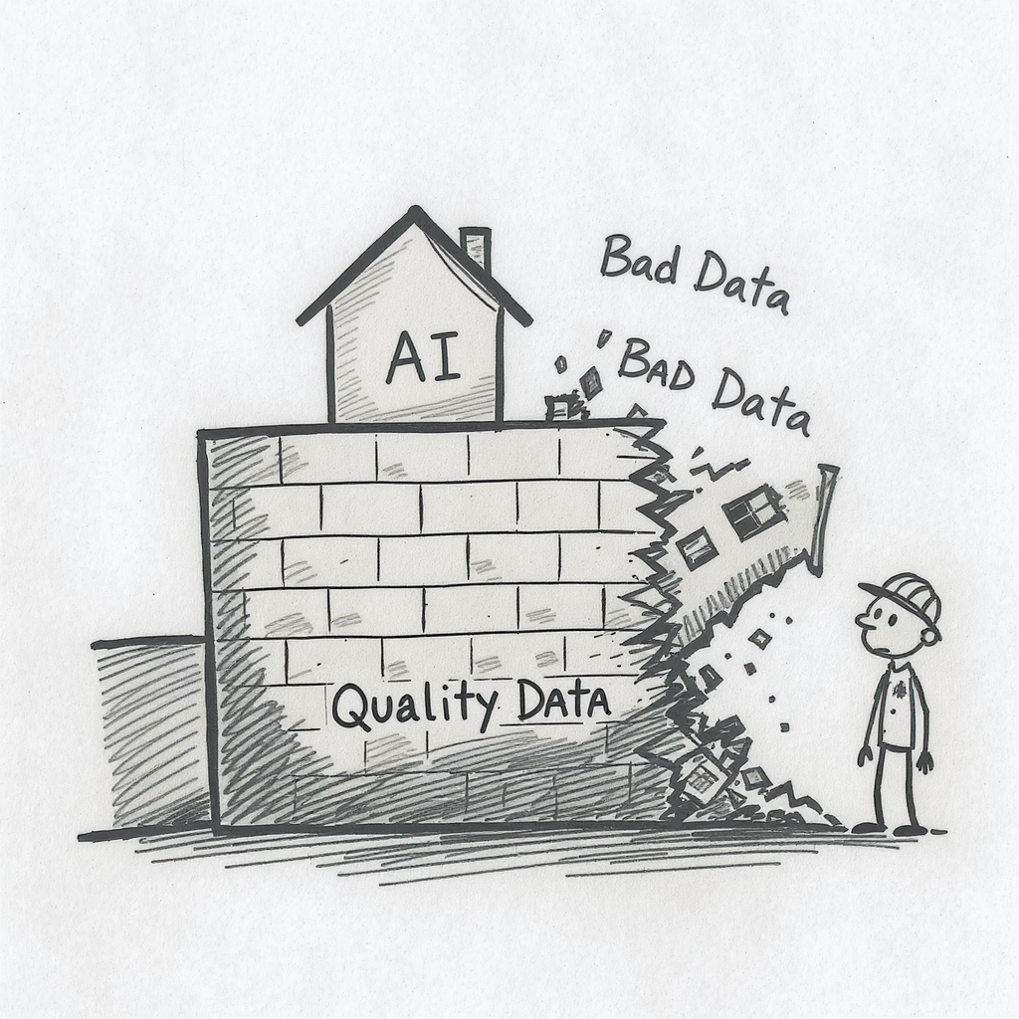
1. Data Dependency
AI Generated Image
Notes:
Traditional IT:
Write code based on business rules
Works regardless of data quality
AI:
Learns patterns from historical data
Quality = Data Quality × Algorithm
Before funding AI: Assess data readiness (0-10 score, need 7+)

Slide 5
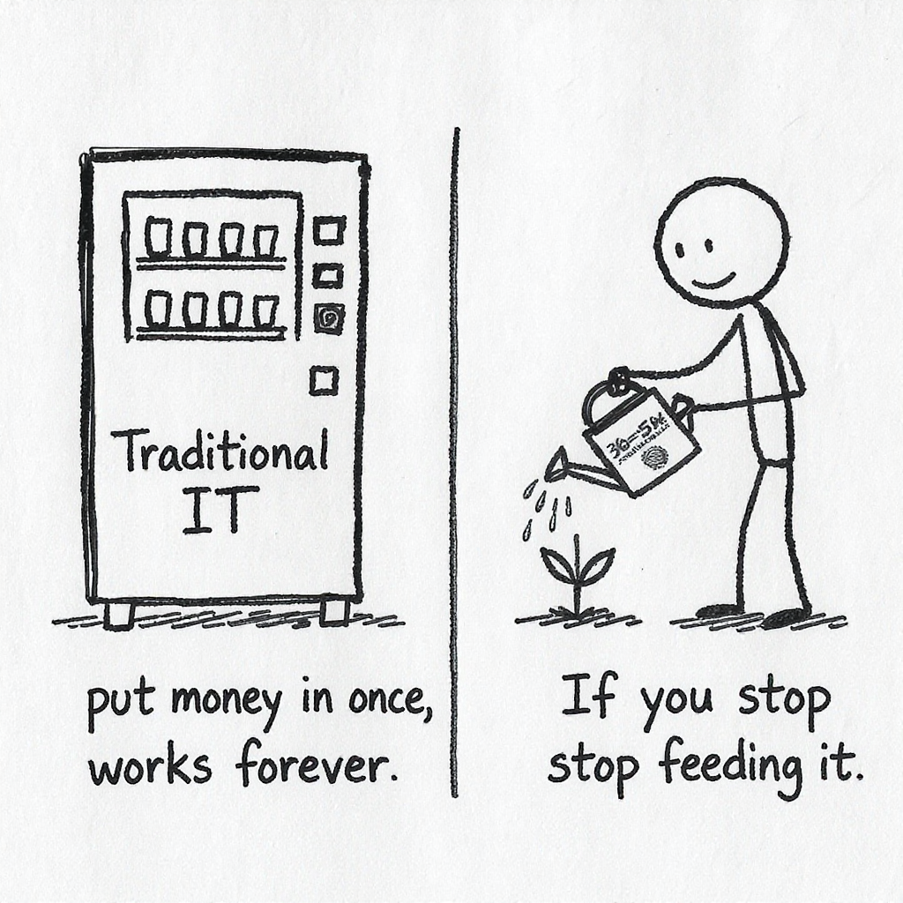
2. Continuous Learning
AI Generated Image
Notes:
Traditional IT:
Build once, maintain 10-15% annually
Predictable costs
AI:
Continuous retraining as world changes
Ongoing costs: 30-50% annually
Calculate 5-year TCO, not just Year 1 cost

Slide 6
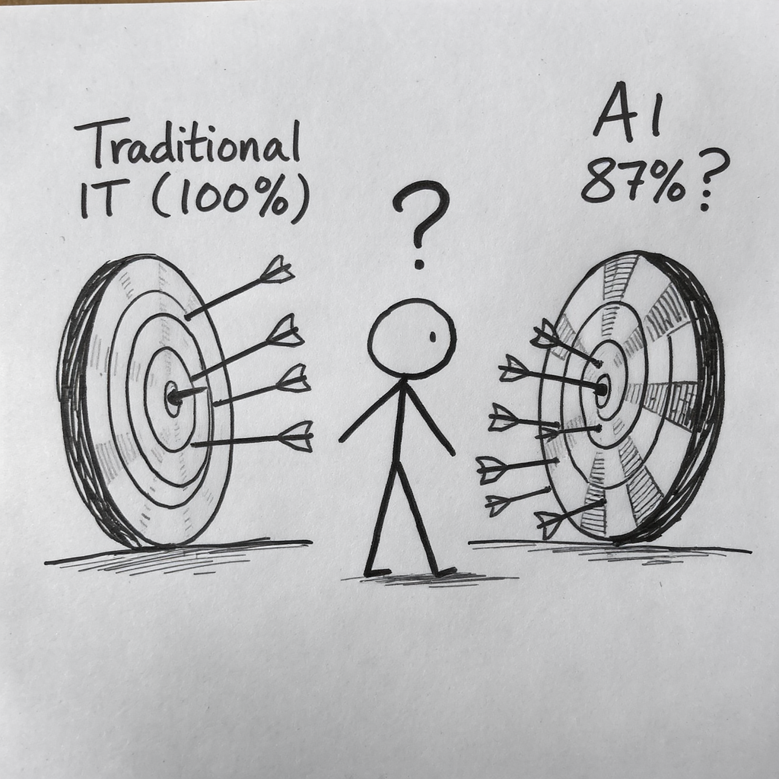
3. Probabilistic Nature
AI Generated Image
Notes:
Traditional IT: Same input = same output (100%)
AI: “I’m 87% confident customer will churn”
Match AI accuracy to business risk tolerance:
Low stakes (recommendations): 70-80% OK
Medium stakes (operations): 85-95% needed
High stakes (medical, financial): 95-99%+ required

Slide 7
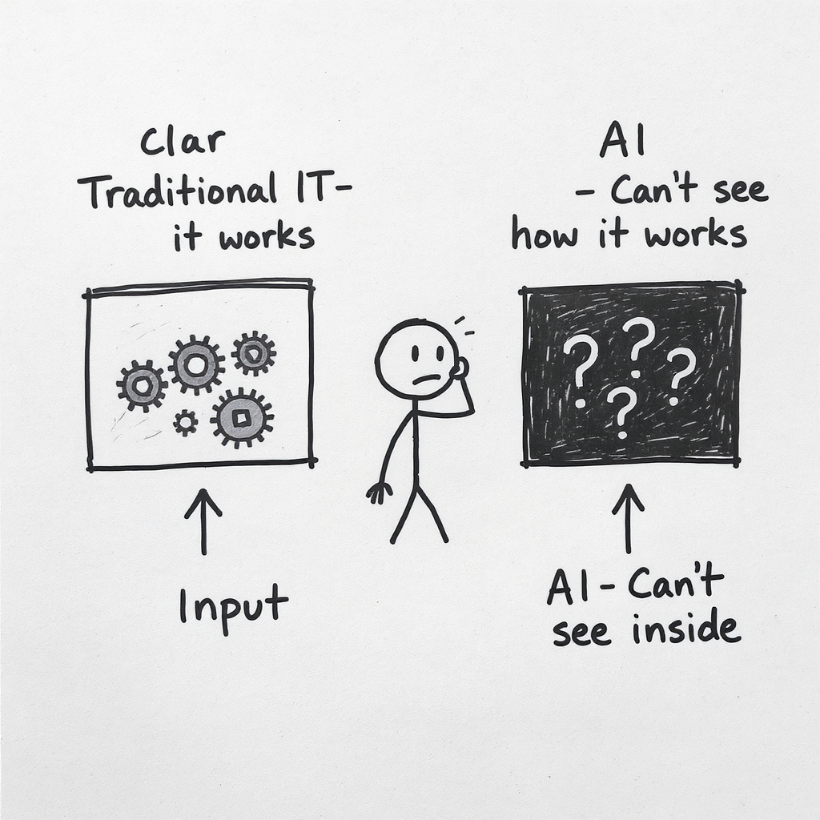
4. Black Box Problem
AI Generated Image
Notes:
Traditional IT:
Trace every decision
Developers explain “why”
AI (especially deep learning):
Input → Black Box → Output
“The model learned that pattern”
High explainability = Limited algorithms + Higher cost (+15-20%)

Slide 8
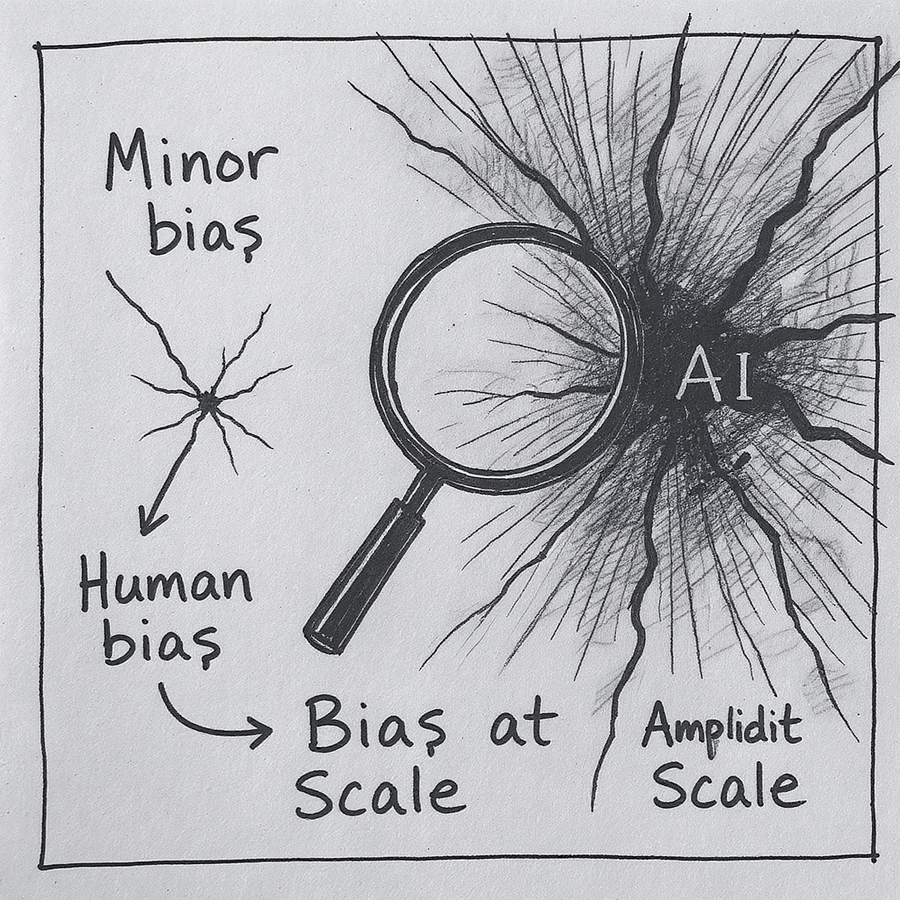
5. Ethical & Bias Risk
AI Generated Image
Notes:
Traditional IT:
Human biases, limited scale
AI:
Learns biases from historical data
Applies at massive scale
Hidden in model
One biased AI = Millions of biased decisions
Budget 10-30% for bias testing, diverse teams, monitoring

Slide 9
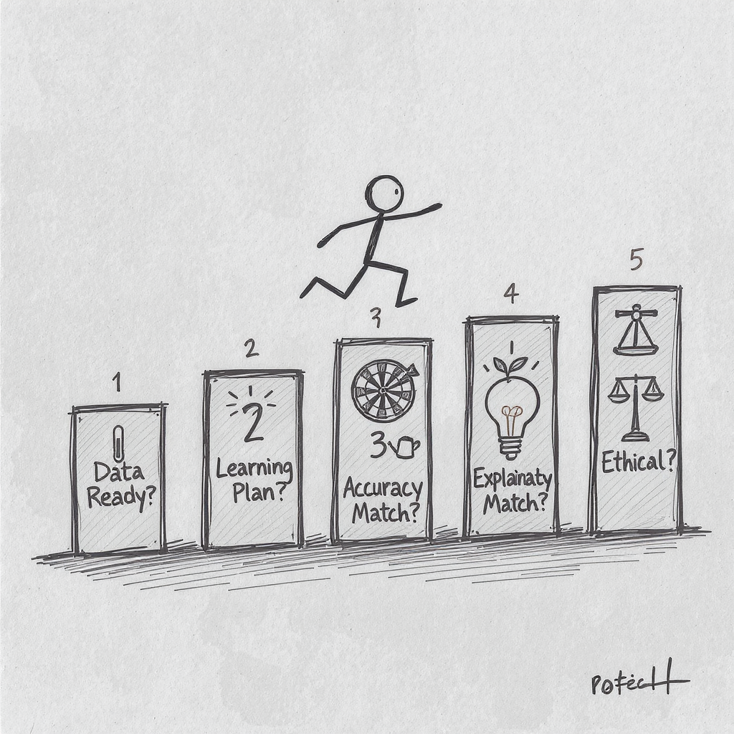
The 5 AI-Specific Criteria
AI Generated Image
Notes:
Every AI investment must answer:
Data Readiness - Score 0-10, need ≥7?
Continuous Learning - 30-50% ongoing cost budgeted?
Accuracy vs. Risk - Does AI capability match requirements?
Explainability - Can we explain decisions (if required)?
Ethical Risk - Have we tested for bias?
Must pass BOTH traditional AND AI-specific criteria

Slide 10
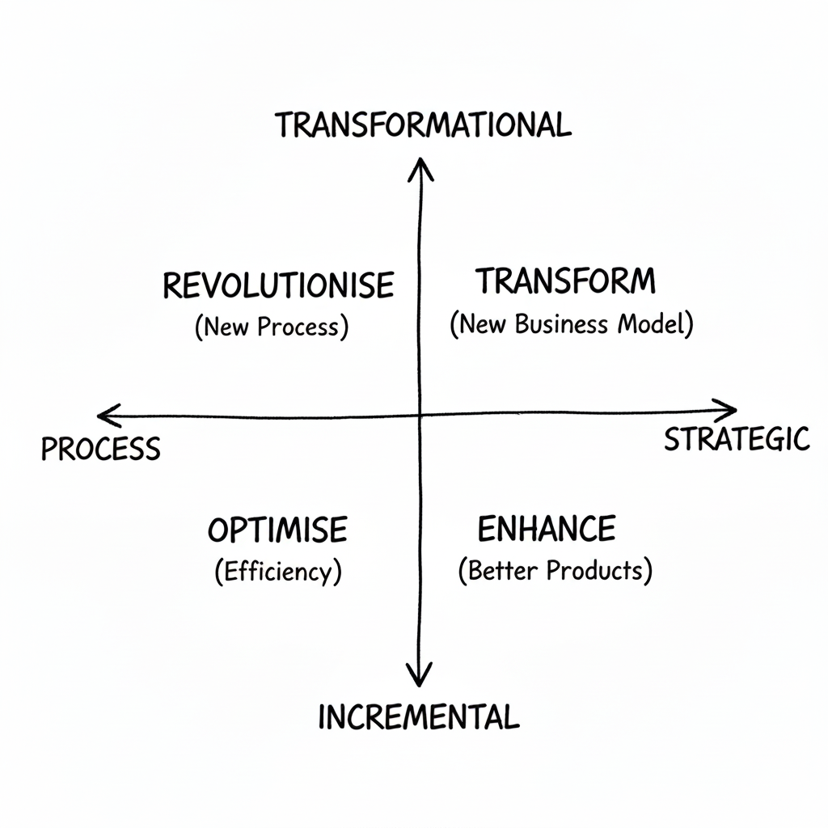
Framework 1: AI Transformation Matrix
AI Generated Image
Notes:
Four Quadrants of AI Impact:
Classify AI initiatives:
OPTIMIZE (Process + Incremental): Efficiency
ENHANCE (Strategic + Incremental): Better products
REVOLUTIONIZE (Process + Transformational): New processes
TRANSFORM (Strategic + Transformational): New business models
Most organizations: 80% in OPTIMIZE quadrant
Use: Identify portfolio balance and gaps
The Innovation Adoption Framework provides a roadmap for implementing AI in organisations
Phase 1 is Knowledge Building - understanding what’s possible before making commitments
Phase 2 is Strategic Alignment - connecting AI initiatives to specific business objectives
Phase 3 is Capability Development - building or acquiring the needed skills and technologies
Phase 4 is Pilot Implementation - testing in controlled environments to demonstrate value
Phase 5 is Organisational Transformation - scaling successful approaches across the business
The Digital Agriculture Services example illustrates this progression
They began by building knowledge about how satellite imagery and ML could predict crop yields
They aligned this with strategic business needs in agricultural insurance and investment
They developed capabilities by building data science teams and satellite imagery processing
Their pilot implementations tested predictions against ground-truth data in specific regions
Now they’re transforming the agricultural intelligence landscape at organisational scale
This framework applies to any significant innovation initiative, not just AI
The key insight: skipping phases often leads to implementation failure
Many organisations jump straight to pilots without strategic alignment or capability building
The KPMG framework provides additional detail on implementing each phase
What phase is your organisation currently in? Are you trying to skip essential steps?

Slide 11
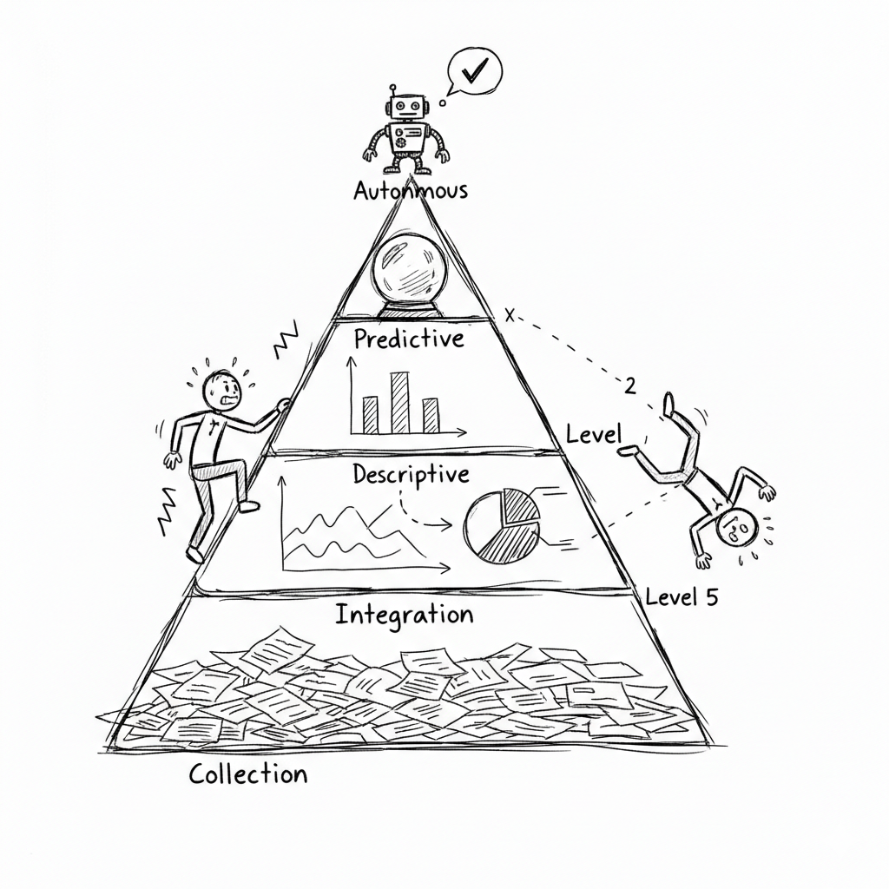
Framework 2: Data Value Pyramid
AI Generated Image
Notes:
5 Levels of Data Maturity:
Level 5: AUTONOMOUS - AI decides and acts
Level 4: PREDICTIVE - Forecast what will happen
Level 3: DESCRIPTIVE - Understand what happened
Level 2: INTEGRATION - Connect data sources
Level 1: COLLECTION - Gather raw data
You cannot skip levels

Slide 12
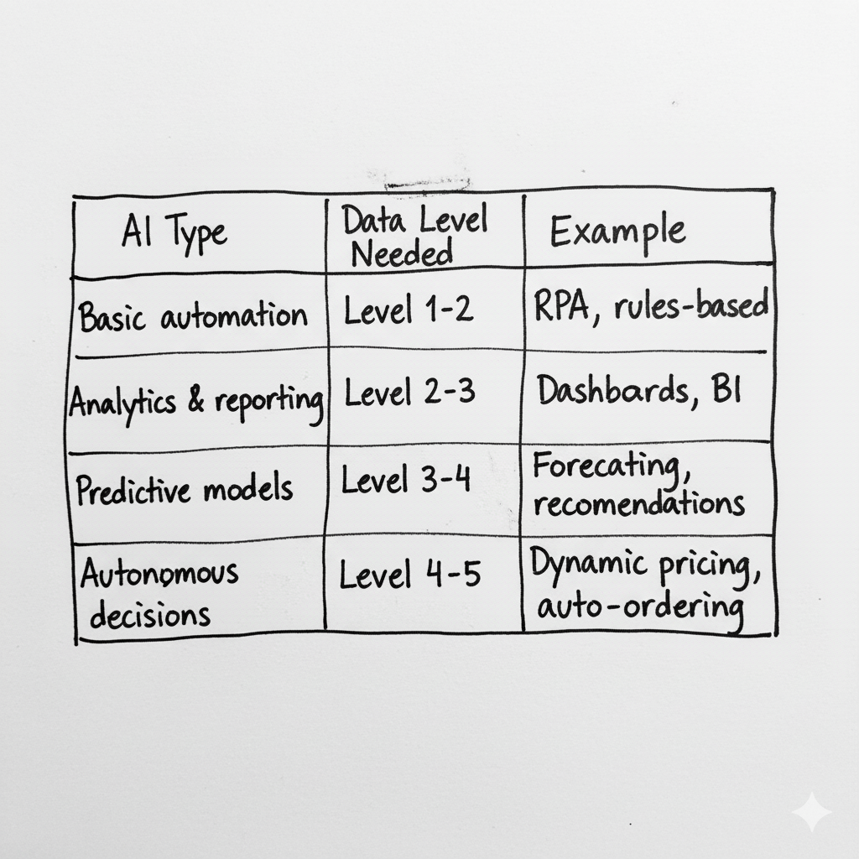
Match AI to Data Maturity
AI Generated Image
Notes:
Assess data maturity BEFORE funding AI

Slide 13
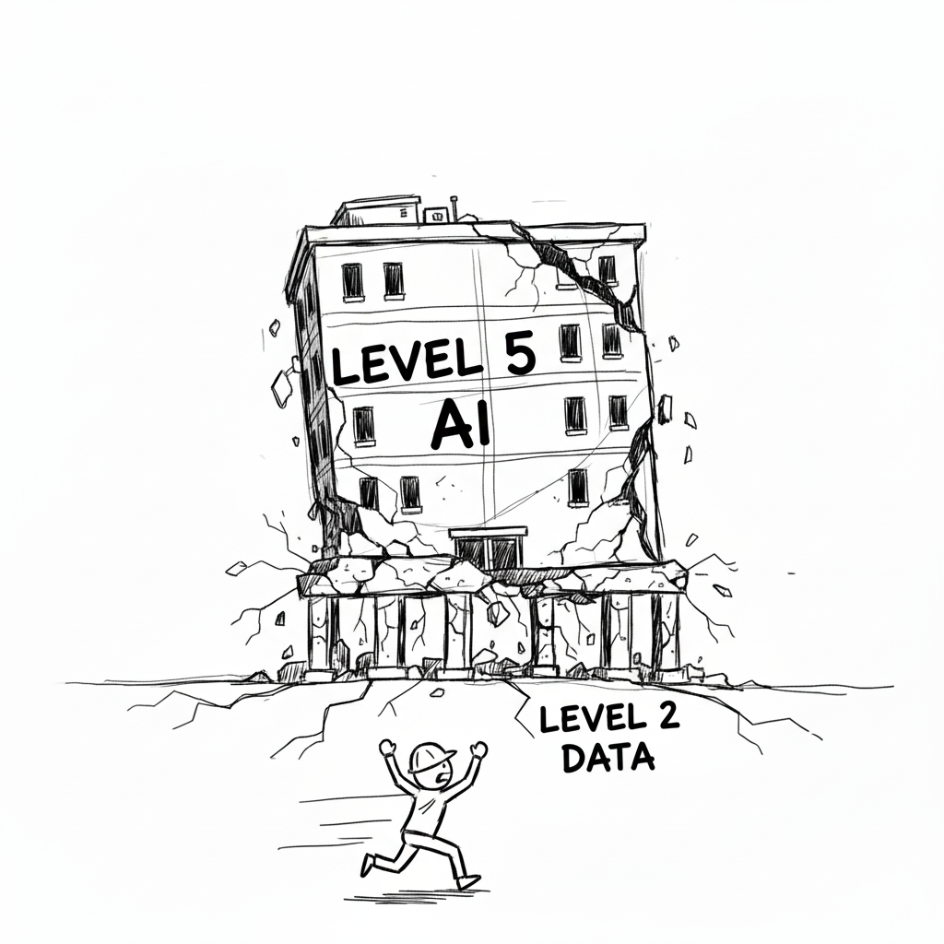
Why 85% of AI projects fail
AI Generated Image
Notes:
If you’re at Level 2, you cannot do Level 5 AI
You will fail.
Most organizations:
Current state: Level 2-3
AI ambition: Level 5
Gap = Why 85% of AI projects fail

Slide 14
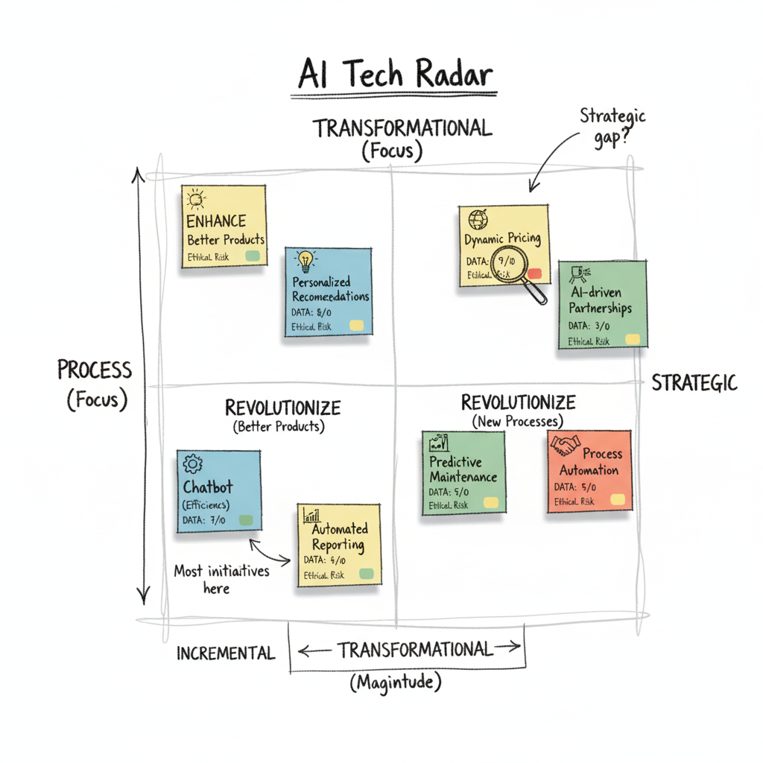
Exercise 1: AI Tech Radar
AI Generated Image
Notes:
Your Task (in table groups):
Map AI capabilities on Transformation Matrix
Assess data readiness for each (0-10 score)
Flag ethical risks (HIGH/MED/LOW)
Output: Where are you today? Where are gaps?

Slide 15

Break
AI Generated Image

Slide 16
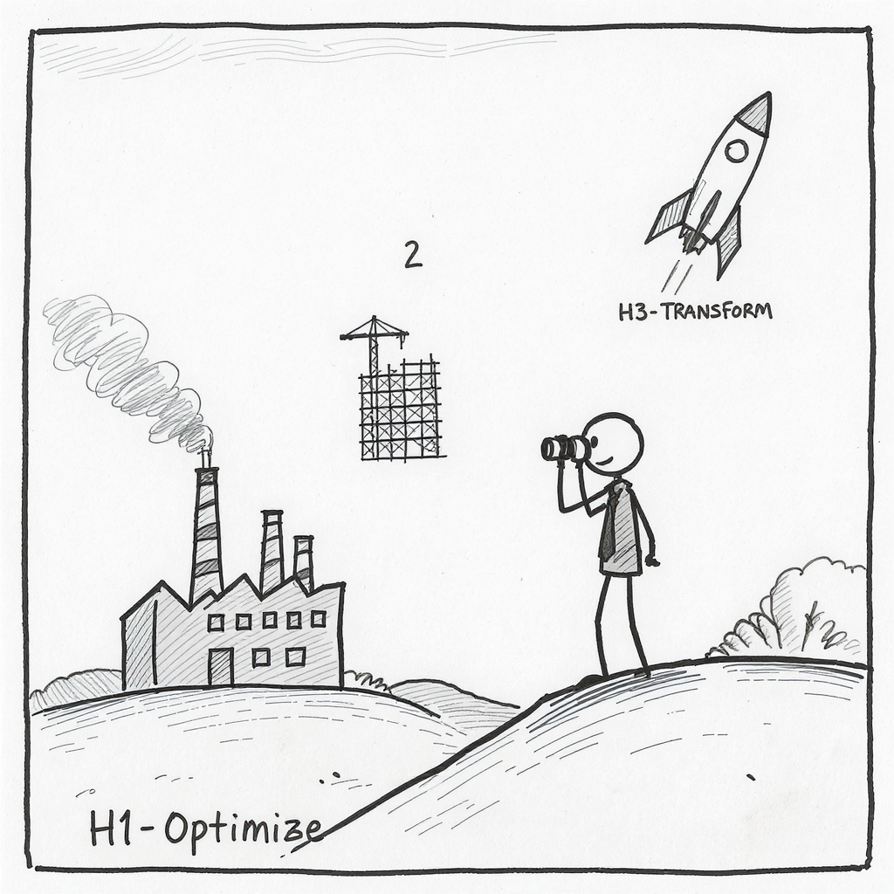
Framework 3: Three Horizons Model
AI Generated Image
Notes:
Balance AI portfolio across timeframes:
Horizon 1 (0-12 mo): Optimize core - 70% of budget
Horizon 2 (1-3 yrs): Build emerging - 20% of budget
Horizon 3 (3-5+ yrs): Create future - 10% of budget
All H1 = No future | All H3 = No present

Slide 17
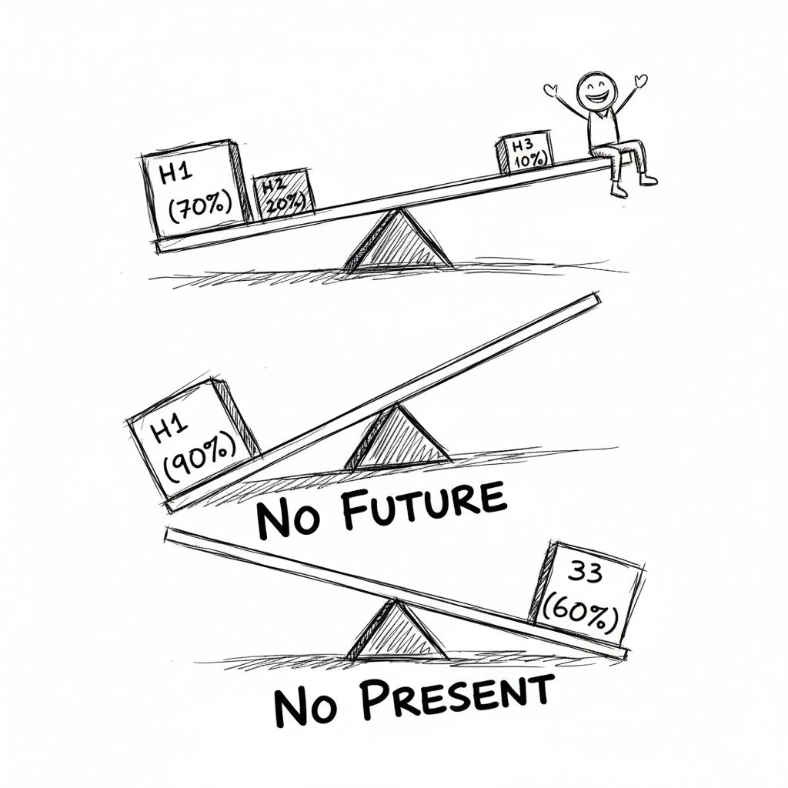
Portfolio Balance
AI Generated Image
Notes:
Most organisations get this wrong:
All H1 (80%+ optimize): Efficient today, irrelevant tomorrow
All H3 (50%+ moonshots): Exciting vision, no cash flow
Right balance: 70/20/10
Audit your AI portfolio: Are you balanced?

Slide 18
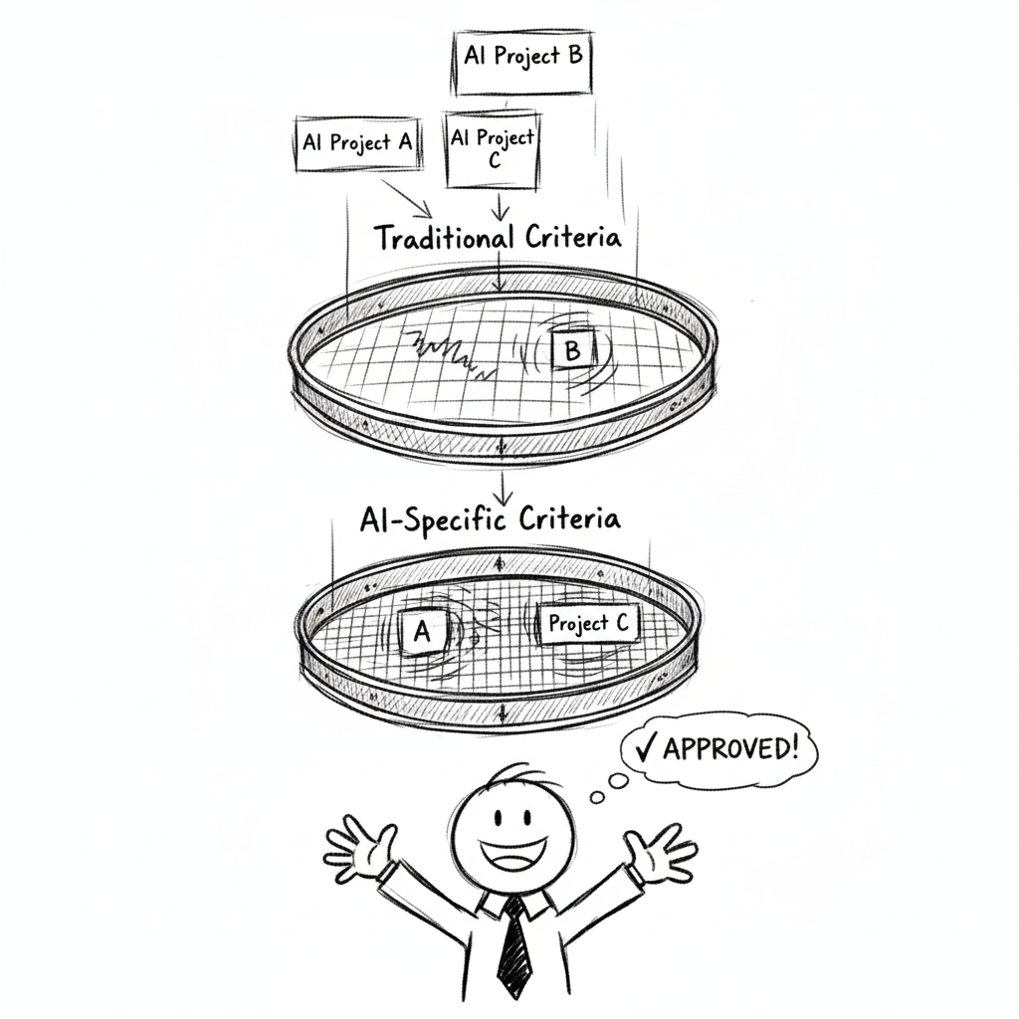
Framework 4: Innovation Adoption Framework
AI Generated Image
Notes:
Even great AI initiatives fail if people don’t adopt them
Technical feasibility ✓
Strong business case ✓
But: 70% of digital transformation fails due to people resistance
Must assess organizational readiness BEFORE investing

Slide 19
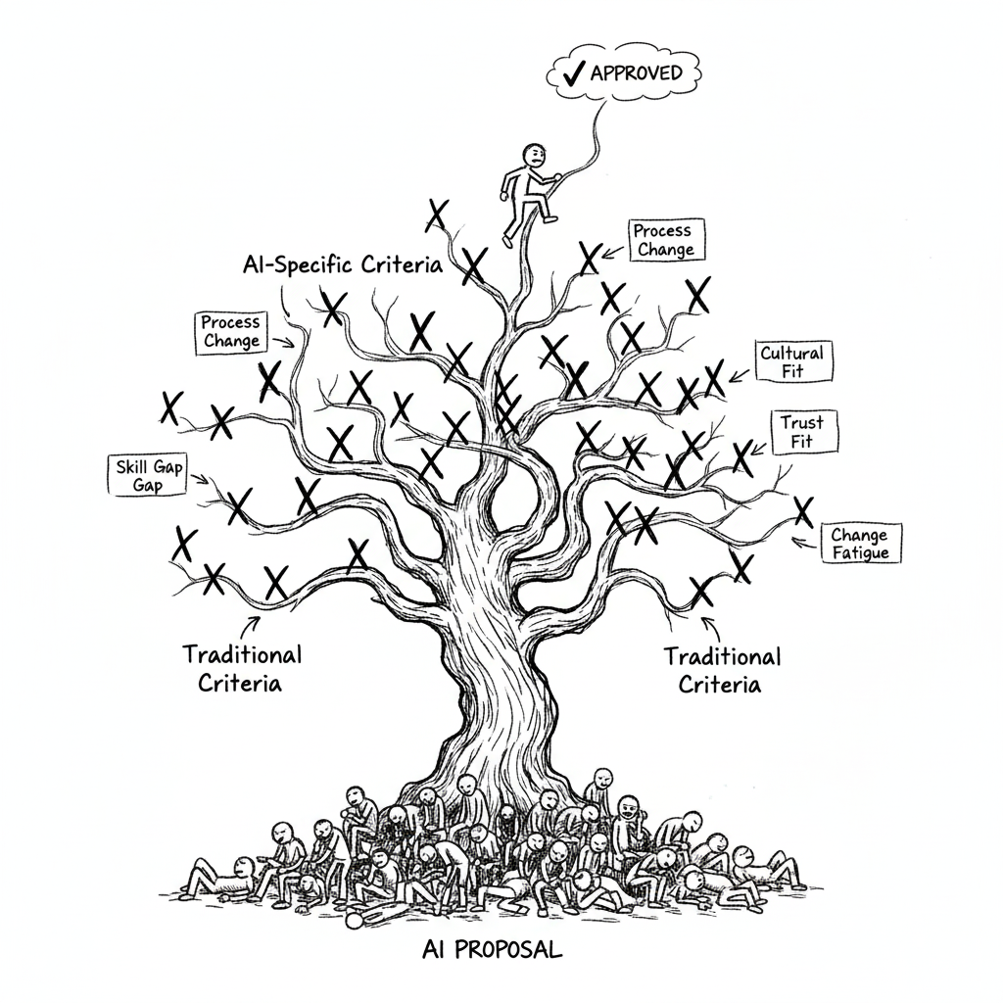
The 5 Adoption Barriers
AI Generated Image
Notes:
Every AI initiative faces resistance:
Skill Gap - Do people have required capabilities?
Process Change - How much disruption to workflows?
Cultural Fit - Does it align with organizational values?
Trust - Do people believe in the technology?
Change Fatigue - Are people exhausted from prior changes?

Slide 20
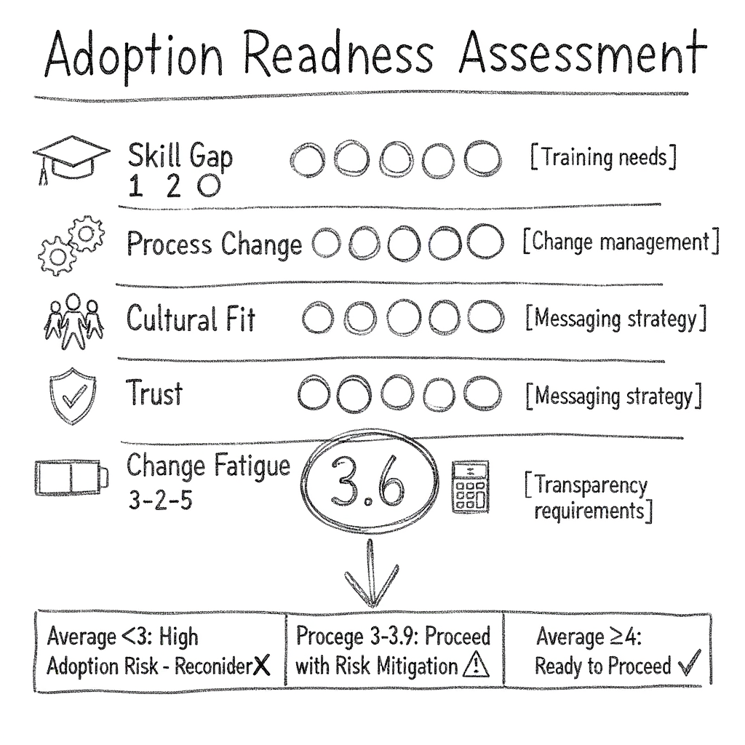
Adoption Readiness Assessment
AI Generated Image
Notes:
Score each barrier 1-5 (5 = low barrier, 1 = high barrier):
Average ≥4: Ready to proceed
Average 3-3.9: Proceed with risk mitigation
Average <3: High adoption risk, reconsider

Slide 21
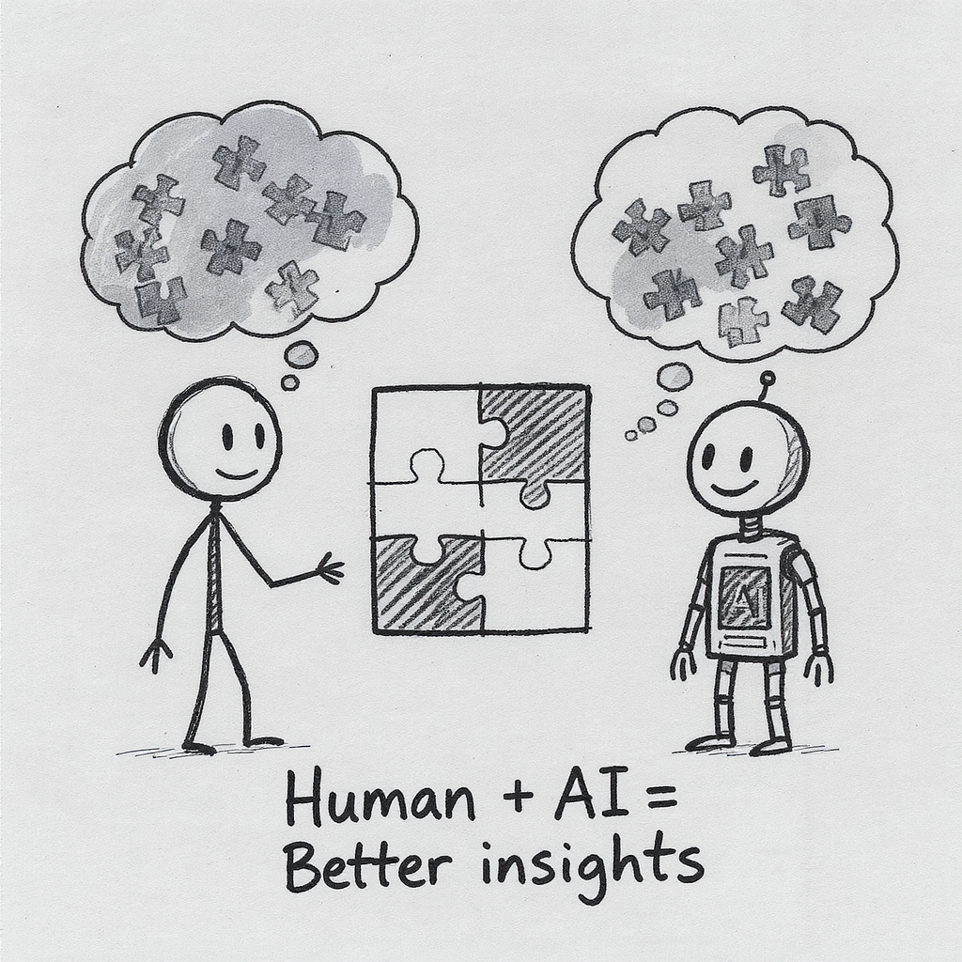
Exercise 2: AI-Assisted Strategic Analysis
AI Generated Image
Notes:
You’ll use AI tools (ChatGPT/Claude/Gemini) for strategic thinking
Three phases:
Human Brainstorm - Your thinking first
AI Augmentation - Use AI to go deeper
Human Synthesis - Compare & learn

Slide 22
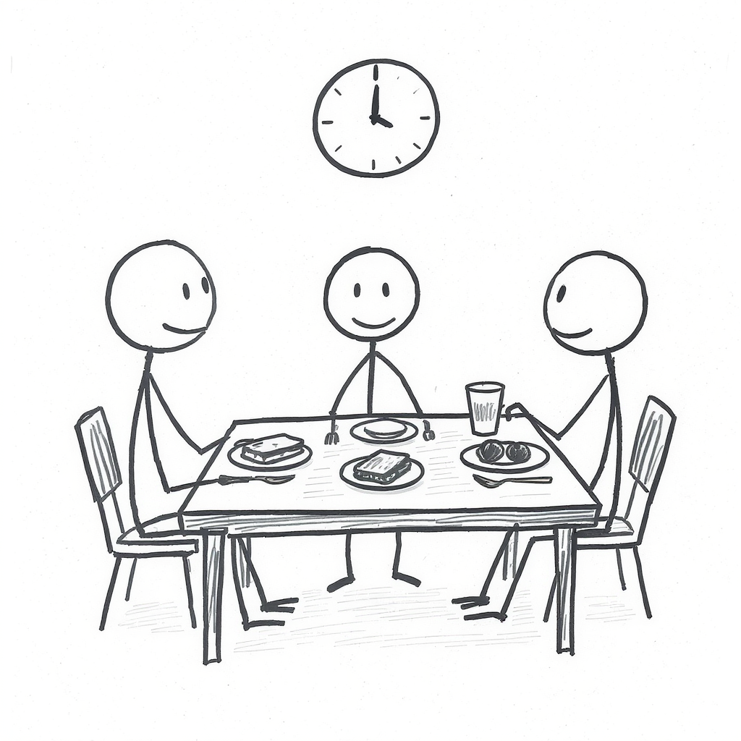
Lunch
AI Generated Image

Slide 23
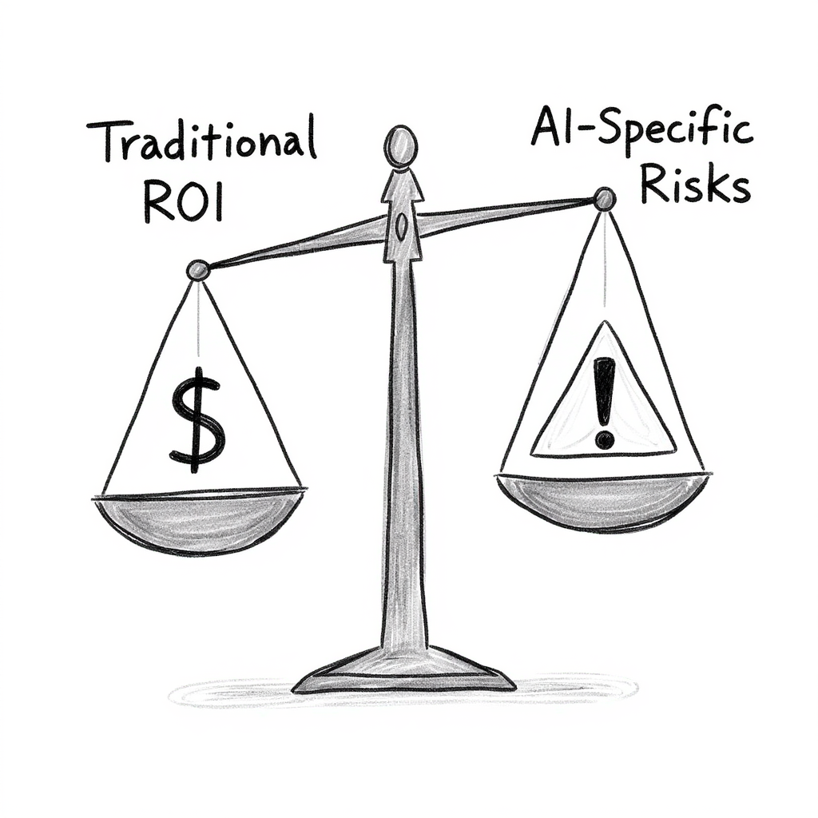
Framework 5: AI Investment Model
AI Generated Image
Notes:
Two-part evaluation:
Part A: Traditional Criteria
Strategic fit (Three Horizons, Transformation Matrix)
Financial ROI (4 value categories)
Implementation feasibility
Part B: AI-Specific Criteria
Data readiness (0-10 score)
Continuous learning plan
Accuracy vs. risk tolerance
Explainability requirements
Ethical risk assessment

Slide 24
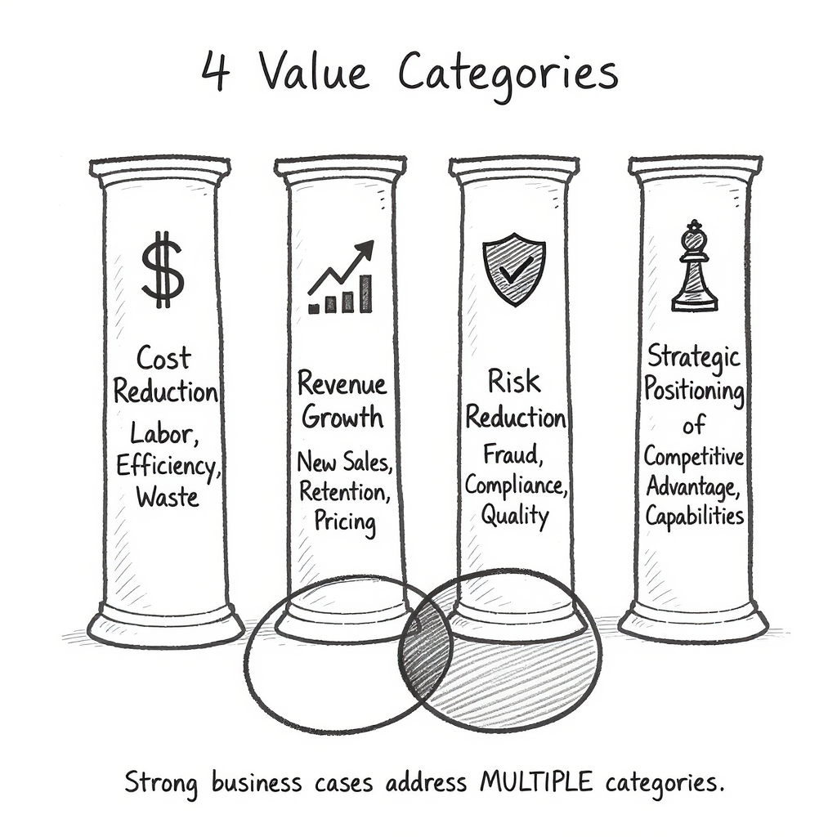
The 4 Value Categories
AI Generated Image
Notes:
Every AI investment creates value across:
Cost Reduction - Labor, efficiency, waste
Revenue Growth - New sales, retention, pricing
Risk Reduction - Fraud, compliance, quality
Strategic Positioning - Competitive advantage, capabilities
Strong business cases address MULTIPLE categories

Slide 25
AI-Specific: The 5 Criteria
AI Generated Image
Notes:
1. Data Readiness (0-10)
Data availability, quality, access, bias
If <7: Stop, fund data infrastructure first
2. Continuous Learning (TCO)
Static (10-15%), Batch (25-30%), Real-time (35-50%)
Calculate 5-year TCO, not just Year 1
3. Accuracy vs. Risk Tolerance
Low stakes: 70-80% OK
Medium: 85-95% needed
High: 95-99%+ required
4. Explainability
HIGH (regulated): Interpretable models only (+15-20%)
MEDIUM (operational): Add explanation tools (+10-15%)
LOW (consumer): Any algorithm OK
5. Ethical Risk Assessment
HIGH (life-impacting): Extensive testing (+20-30%)
MEDIUM (customer-facing): Bias testing (+10-15%)
LOW (internal): Basic review (+5%)
Budget for bias testing, diverse teams, monitoring

Slide 26
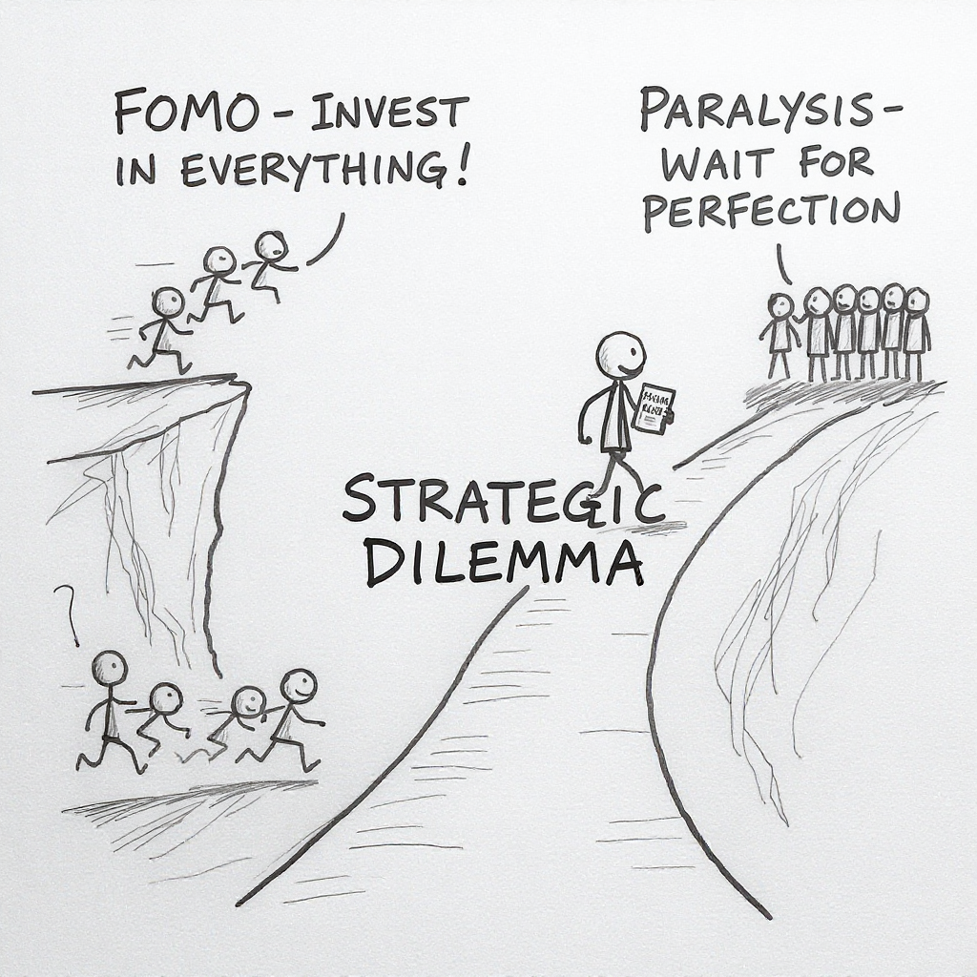
The Strategic Dilemma
AI Generated Image
Notes:
If you used ONLY traditional ROI:
Fraud Detection: 315% ROI ← Fund this
Inventory: 264% ROI ← Fund this
Dynamic Pricing: 253% ROI ← Maybe this?
Chatbot: 92% ROI ← Don’t fund
But after AI-specific analysis:
Fraud: Data not ready (need 6 months prep first)
Inventory: Exceeds budget cap
Dynamic Pricing: HIGH ethical/bias risk
Chatbot: Only one that’s truly ready ✅
Traditional criteria would fund the WRONG projects

Slide 27
Break
AI Generated Image

Slide 28
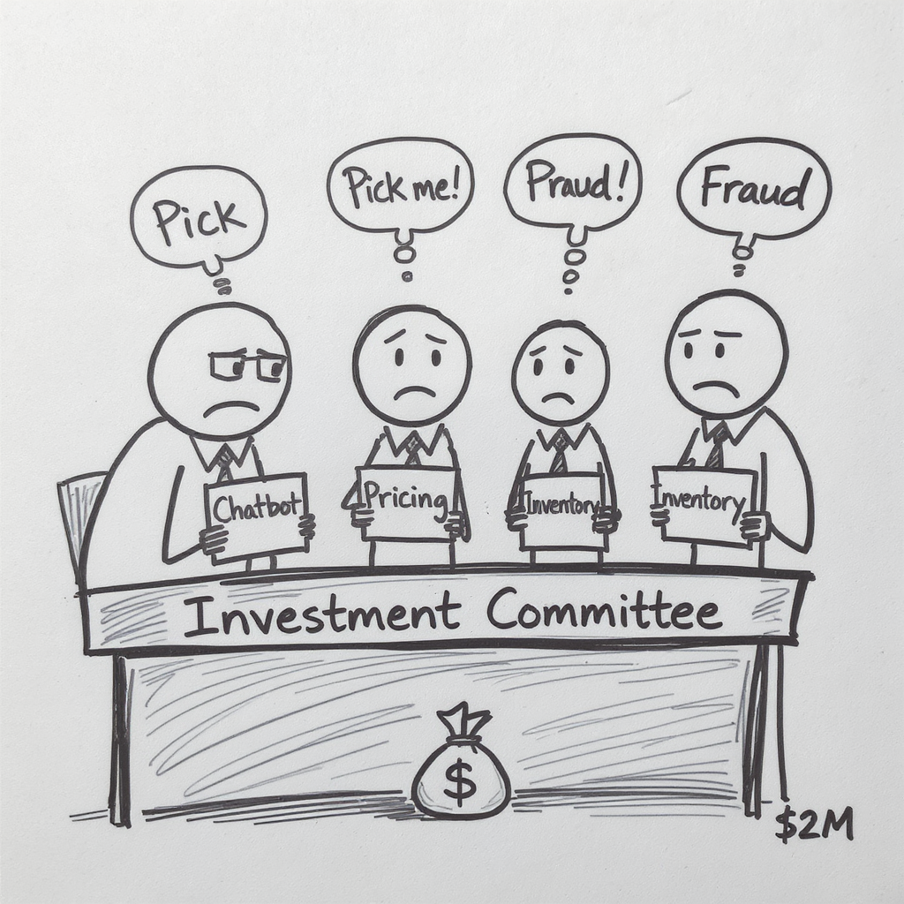
Exercise 3: Dragon’s Den
AI Generated Image
Notes:
Strategic stress test of the AI Investment Model:
RetailFlow has $2M budget, $2.95M in requests
4 competing initiatives, all with strong ROI
You cannot fund everything
The test: Do AI-specific criteria change your decisions?
Your task:
Project teams: Build investment case using AI criteria
Investment committee: Evaluate using complete framework

Slide 29
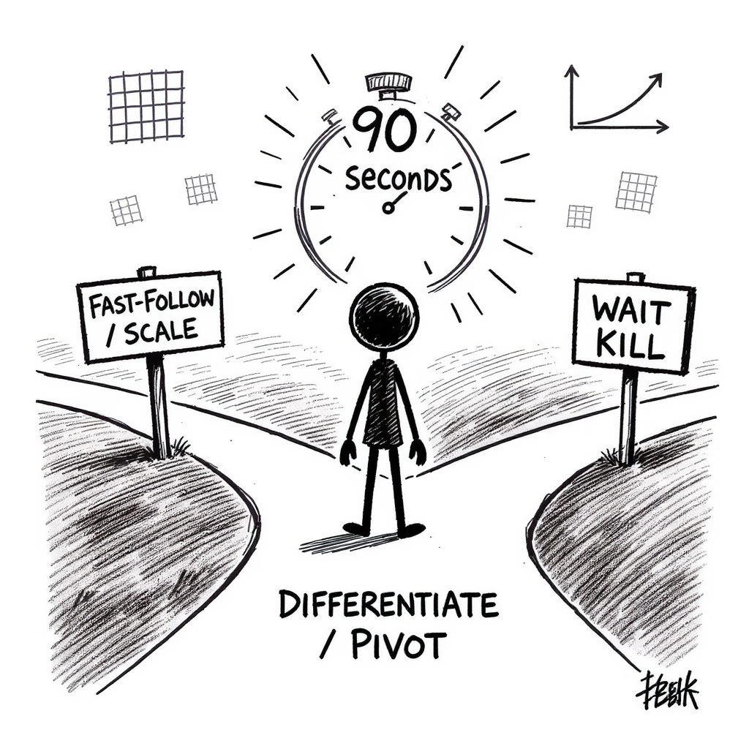
Exercise 4: Strategic Response Scenarios
AI Generated Image
Notes:
Three rapid-fire strategic decisions with anonymous voting (MS Forms).
Apply frameworks to realistic dilemmas: competitive threats, pilot performance, emerging technology timing.

Slide 30
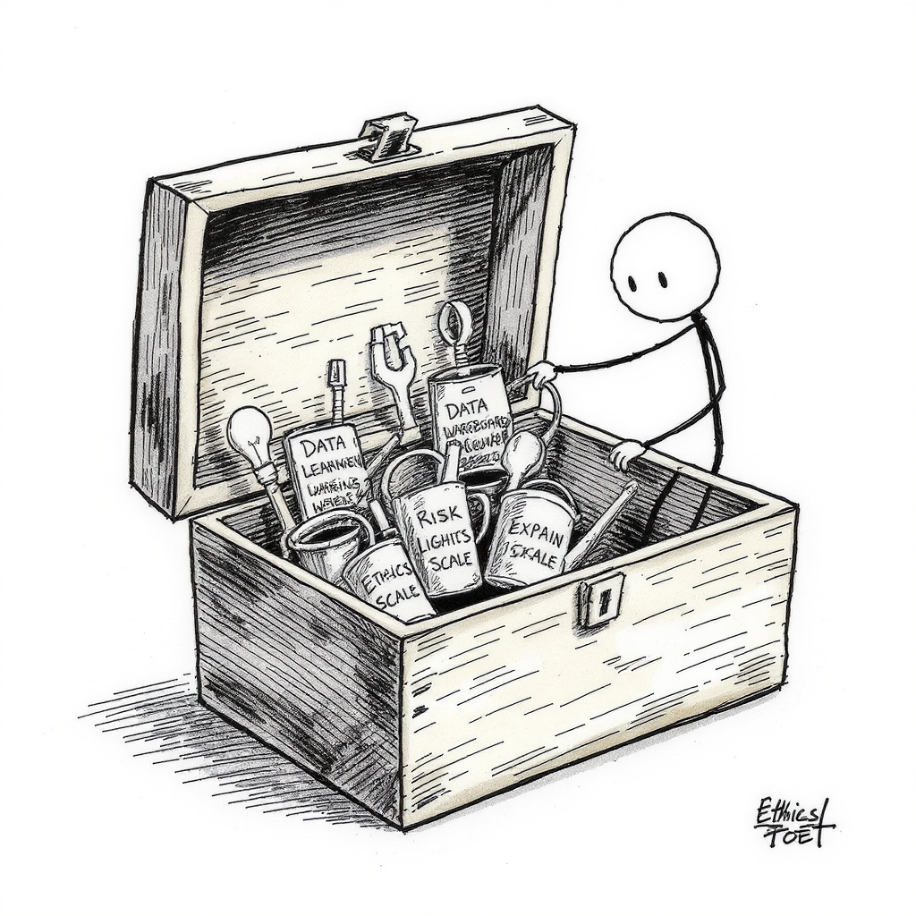
What You Learned Today
AI Generated Image
Notes:
AI investments require DIFFERENT evaluation:
Data readiness gates everything (6/10 = delay the project)
Ongoing costs are 3-5x higher (30-50% vs. 10-15%)
Ethical risks are existential (one biased AI = massive damage)
Explainability isn’t optional (regulated industries)
Highest ROI ≠ best investment (must pass AI criteria too)

Slide 31
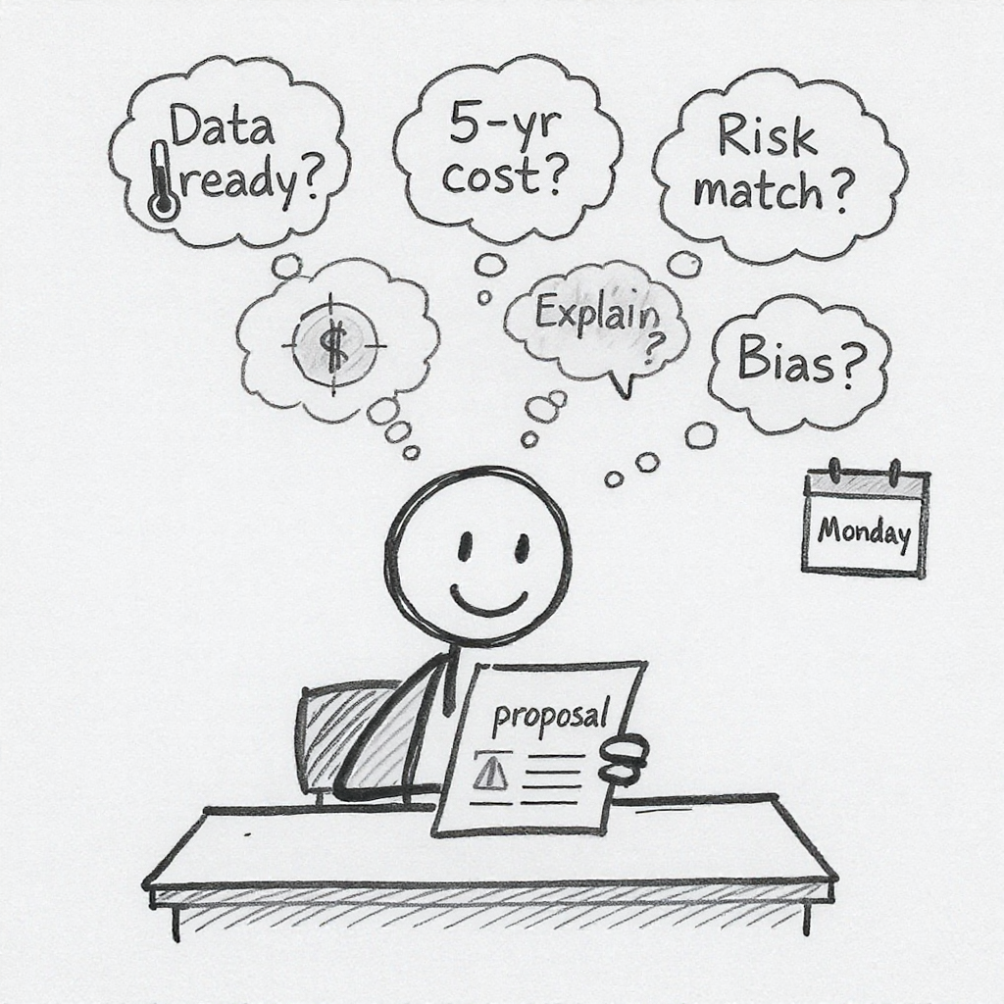
The Monday Morning Test
AI Generated Image
Notes:
Next AI proposal you see, ask these 5 questions:
What’s our data readiness score? (0-10, need ≥7)
What’s the 5-year TCO? (not just Year 1 build cost)
What’s the cost of being wrong? (accuracy requirement)
Must we explain AI decisions? (regulatory/trust)
Could this discriminate? (bias testing plan)
If they can’t answer all 5, you’re not ready to approve
This is your new governance standard.

Slide 32
The 5 Frameworks: Summary
Framework 1: AI Transformation Matrix - Portfolio balance
Framework 2: Data Value Pyramid - Match AI to data maturity
Framework 3: Three Horizons Model - Balance across timeframes
Framework 4: Innovation Adoption - Organizational readiness
Framework 5: AI Investment Model - Traditional + AI-specific criteria

Slide 33
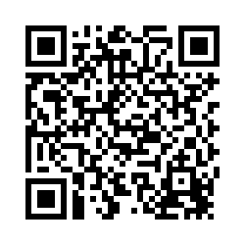
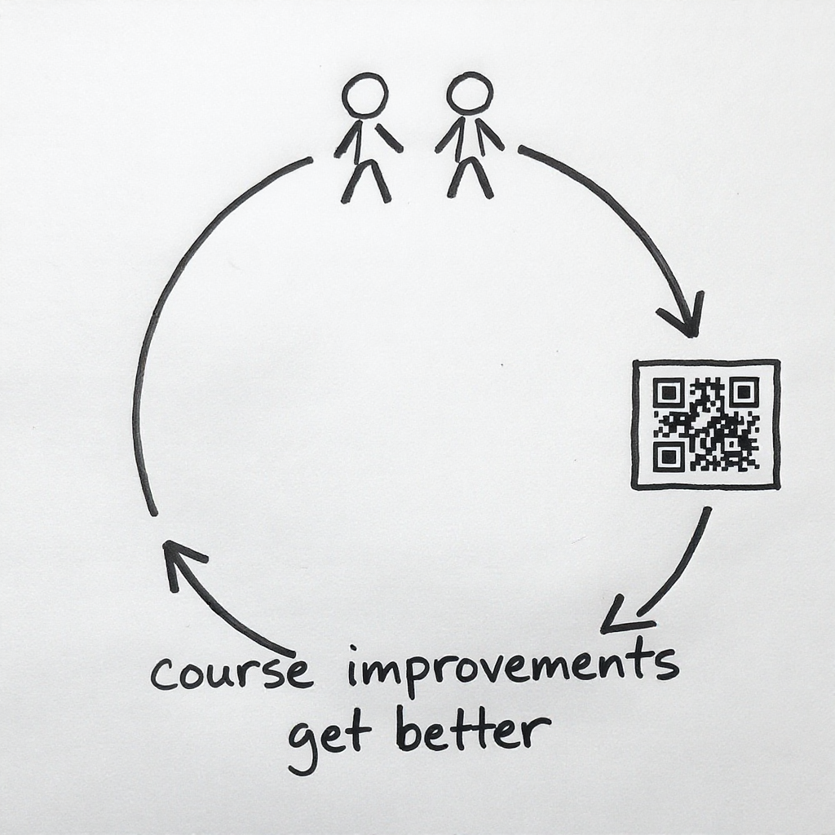
Thank You
AI Generated Image
Contact: michael.borck@curtin.edu.au
Materials: https://exec-ed.github.io/ai-business-innovation/
Notes:
You now have:
✅ 5 strategic frameworks
✅ AI Investment Checklist
✅ Understanding of what makes AI different
Use them Monday morning.

